Slide 1
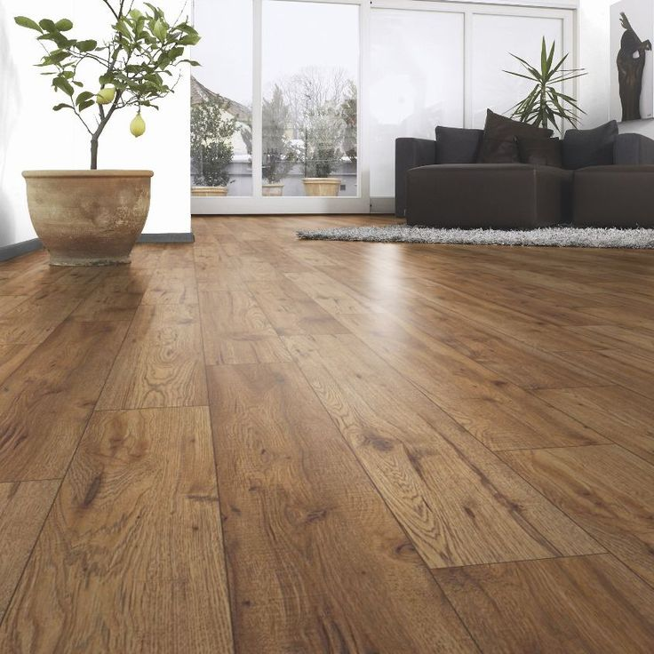
Kajaria Tiles Australia
Hybrid Catalogue

Slide 2
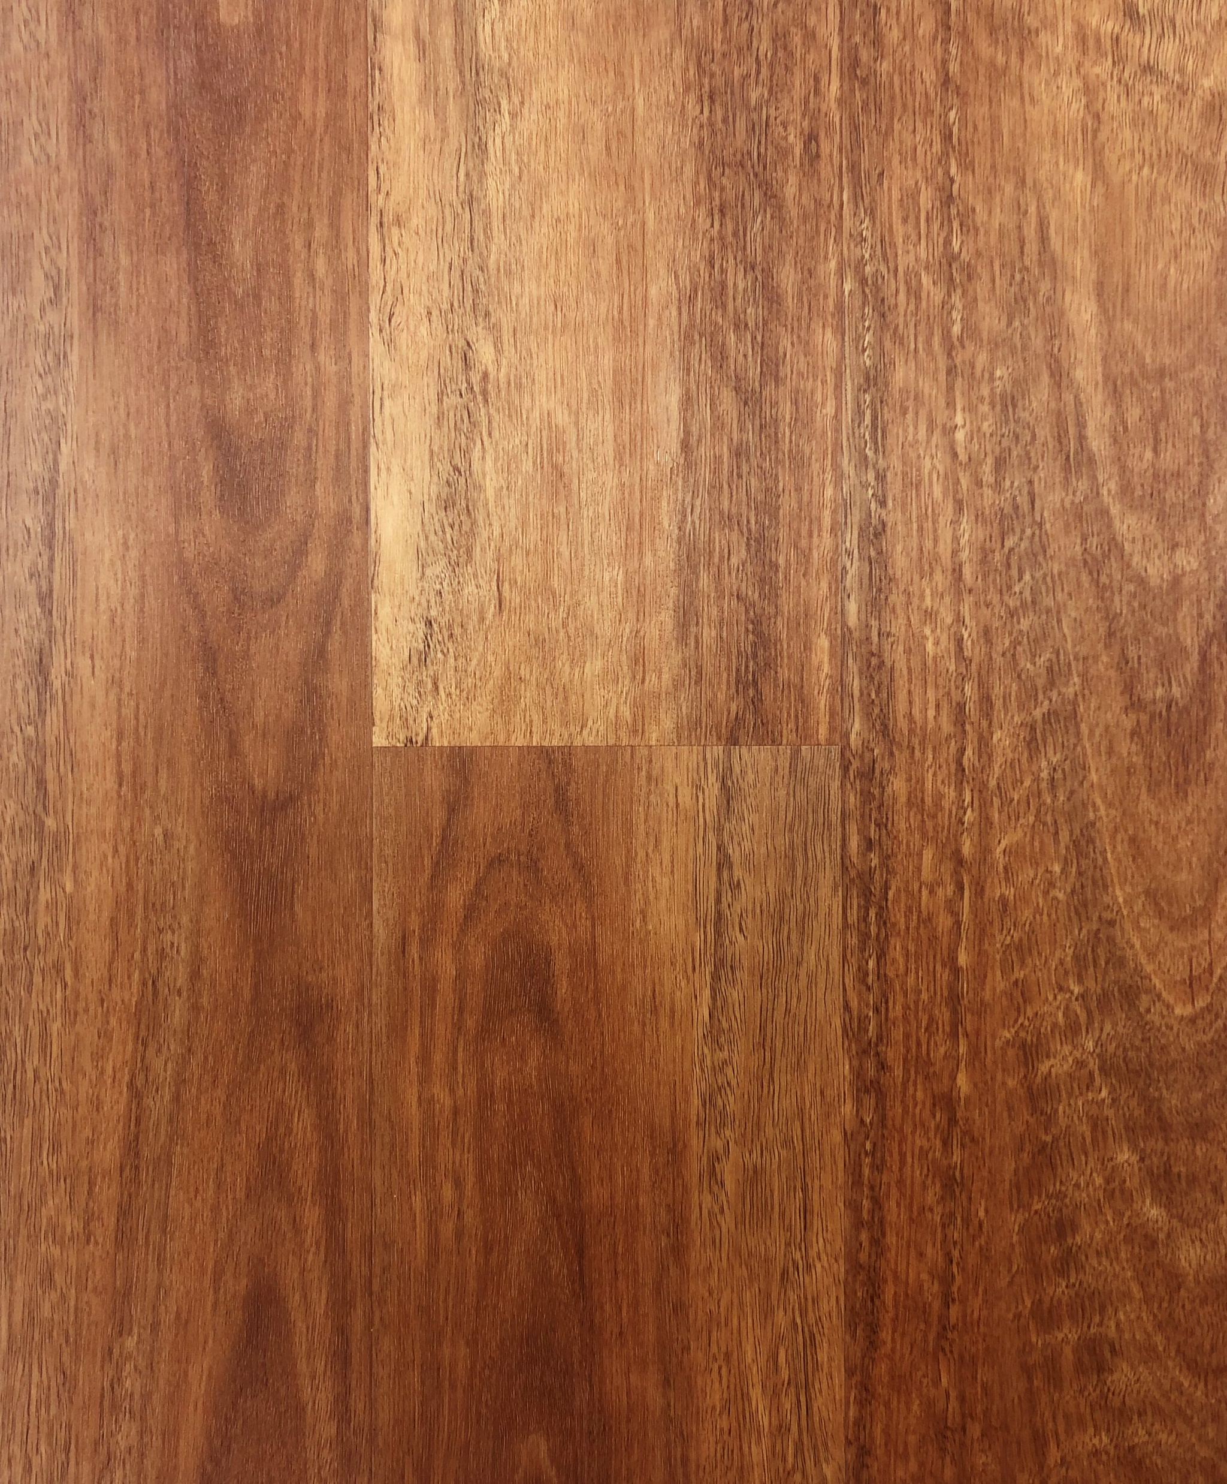
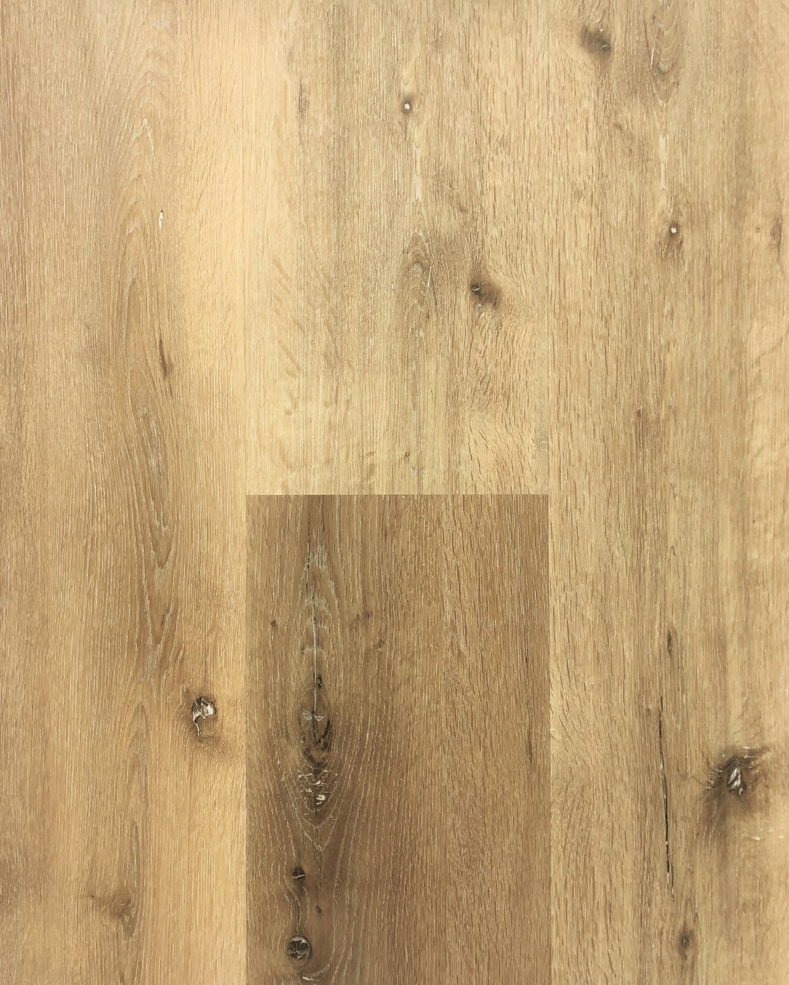
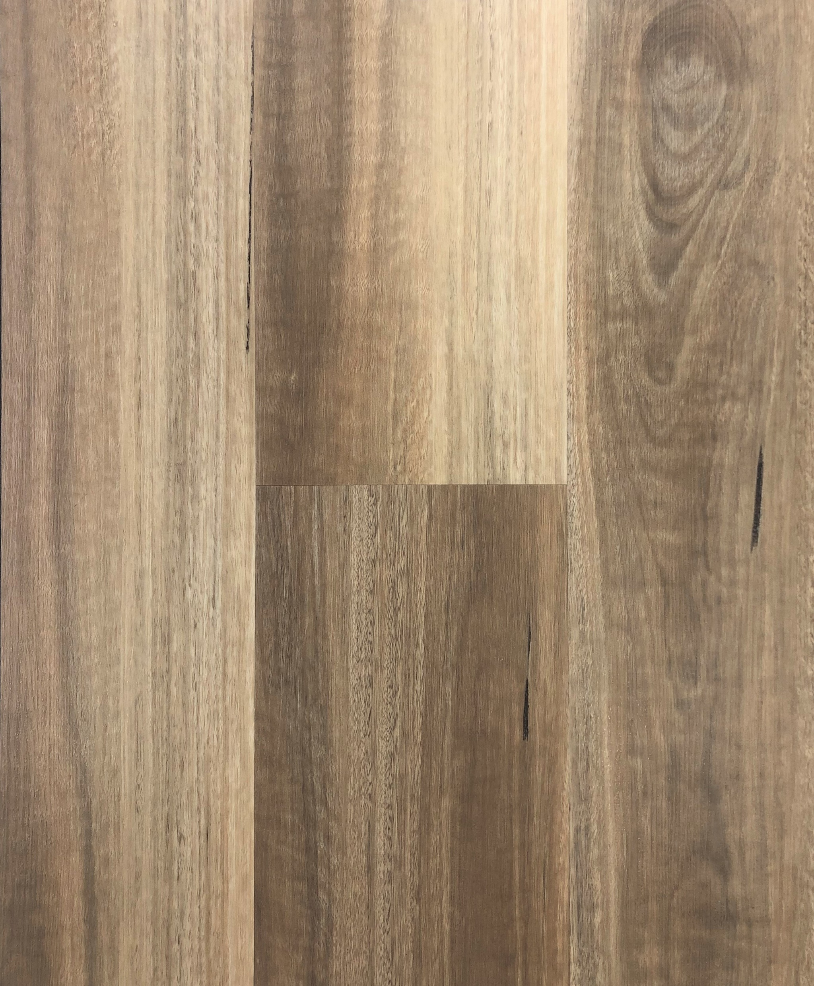
COFFEE
(KTA_NDT-7719)
Hybrid Planks (228x1524x7mm (2mm Lining))
NATURAL WILD OAK
(KTA_NTD-7712)
Hybrid Planks
(228x1524x7mm (2mm Lining))
SPOTTED GUM
(KTA_NTD-7710)
Hybrid Planks
(228x1524x7mm (2mm Lining))

Slide 3
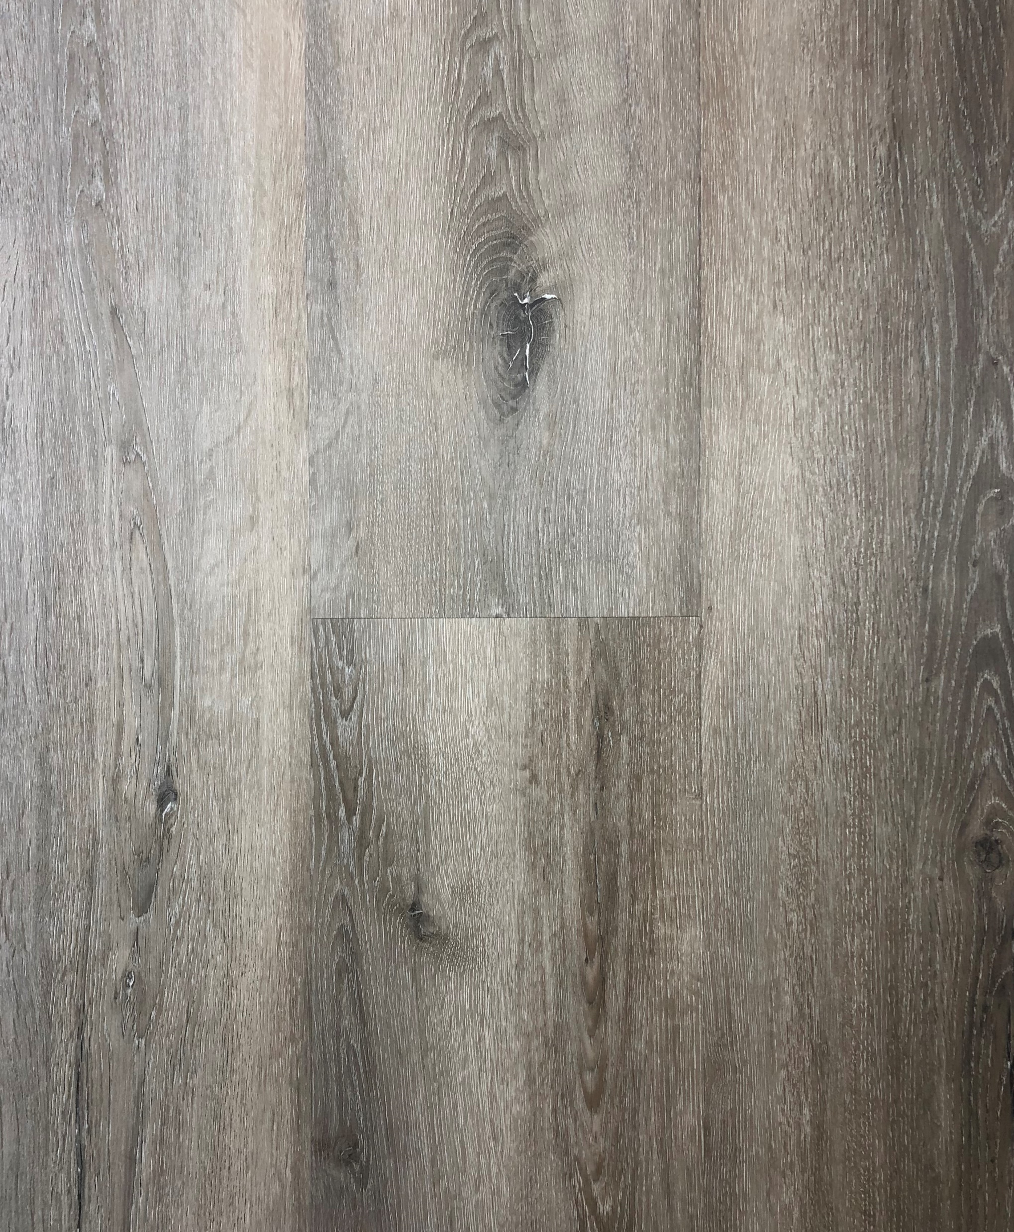
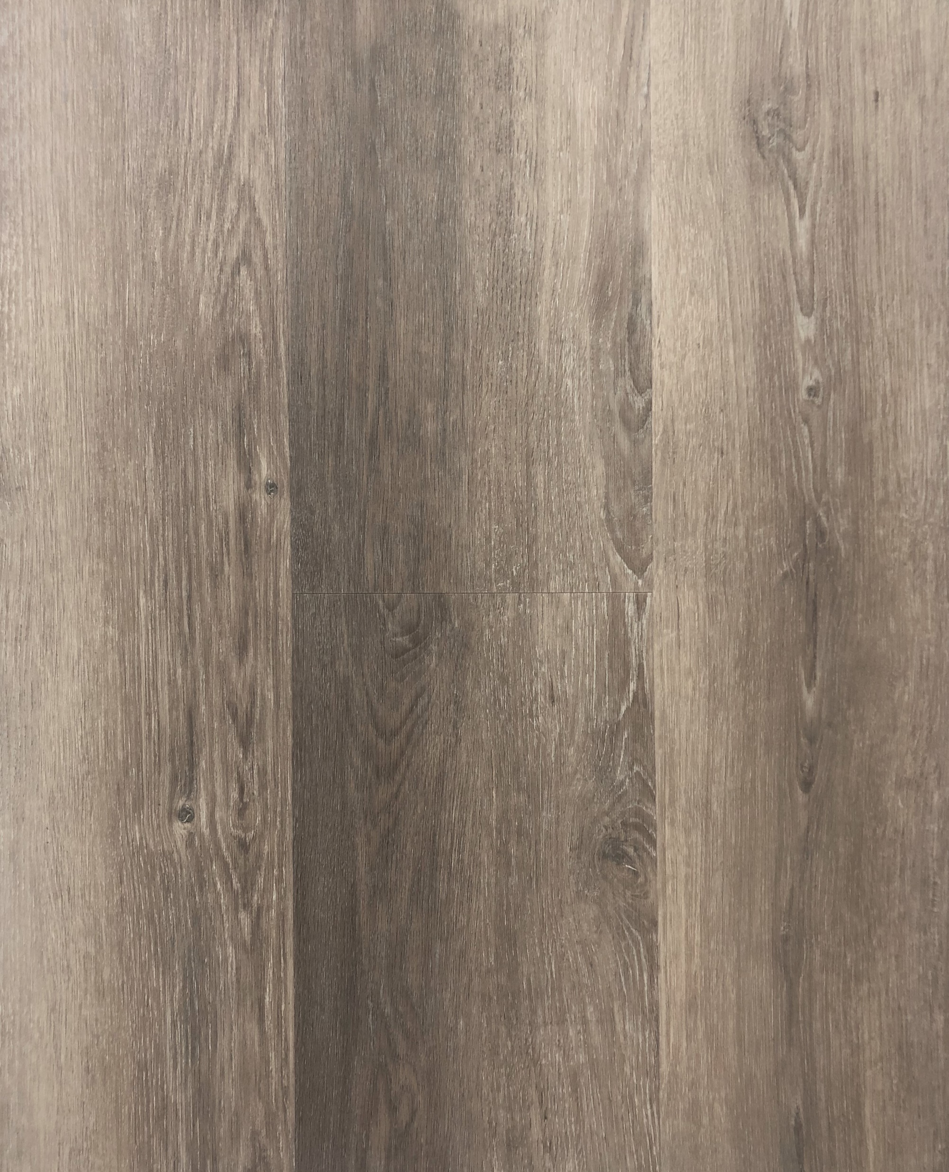
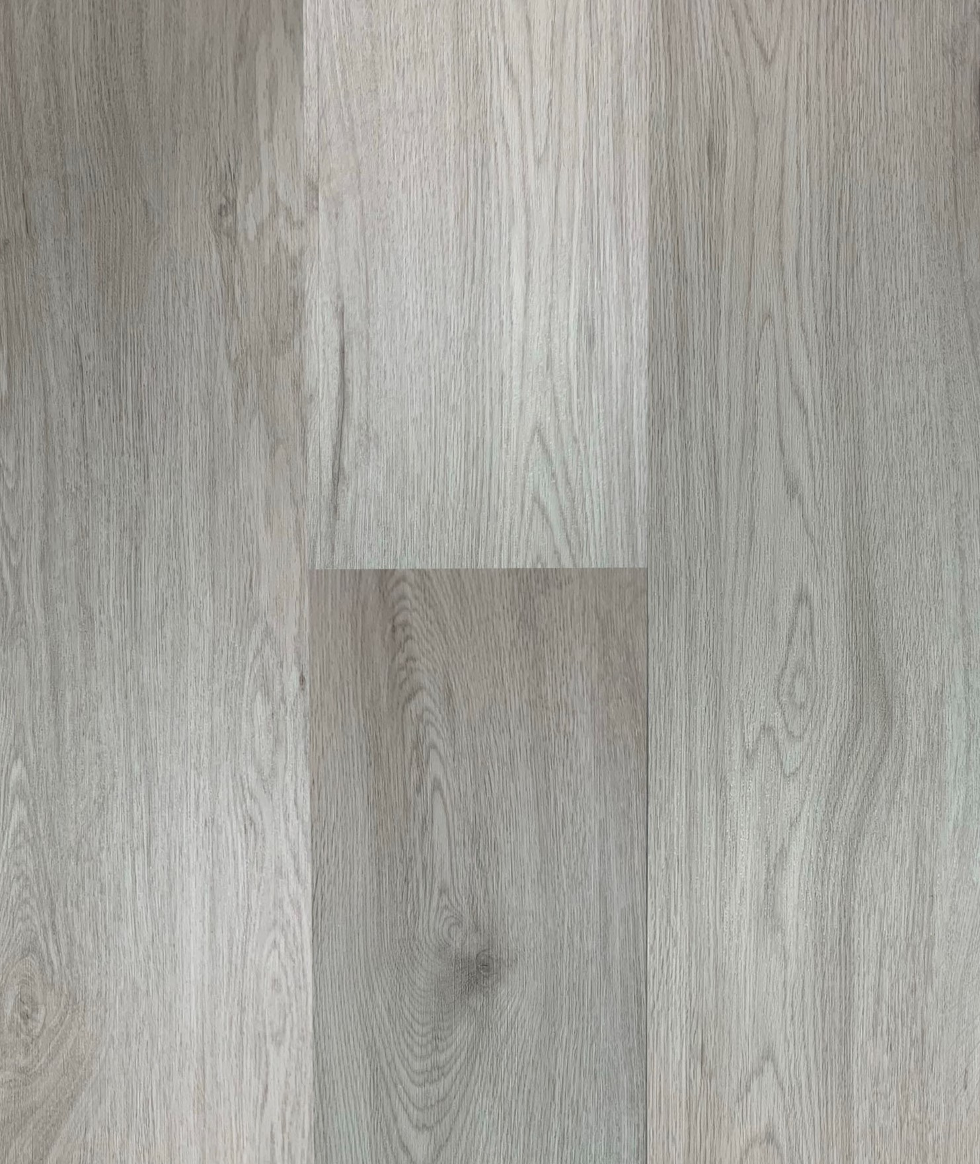
GREY OAK
(KTA_NTD-7717)
Hybrid Planks
(228x1524x7mm (2mm Lining))
NEVADA OAK
(KTA_NTD-7127)
Hybrid Planks
(228x1524x7mm (2mm Lining))
GHOST GREY
(KTA_NTD-7709)
Hybrid Planks
(228x1524x7mm (2mm Lining))

Slide 4
HYBRID TECHNICAL SPECIFICATIONS
Made from recycled materials
100% Waterproof
Antibacterial
Floating Installation
Length – 1524mm
Width – 228mm
Thickness – 5mm + 2mm Lining
6 Pieces / Box
2.08 SQM/ Box
Tongue & Groove Click System Connection
Warranty – Residential – 20 Years.
Warranty – Light Commercial – 10 Years.
KAJARIA TILES AUSTRALIA
ABN: 49 152 252 429
Phone: +61 3 8759 5042 Email: info@kajariatiles.com.au
DOVETON SHOWROOM
Unit 2, 10 Princes Highway
Doveton, VIC, 3177
CAMPBELLFIELD SHOWROOM
31A Metrolink Circuit,
Campbellfield, VIC, 3061

