Slide 1
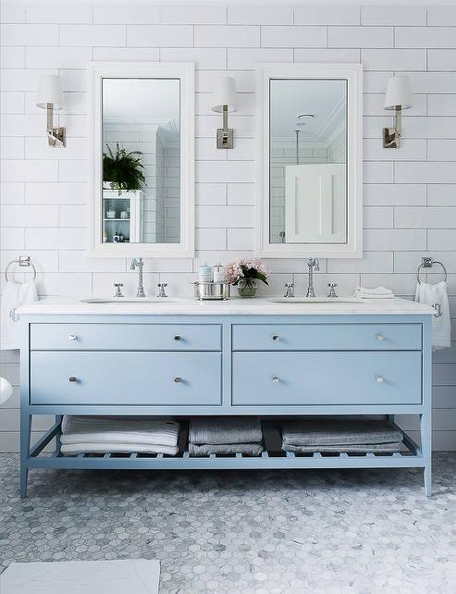
Kajaria Tiles Australia
Mosaics and Subways Catalogue

Slide 2
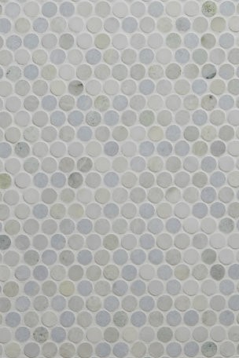
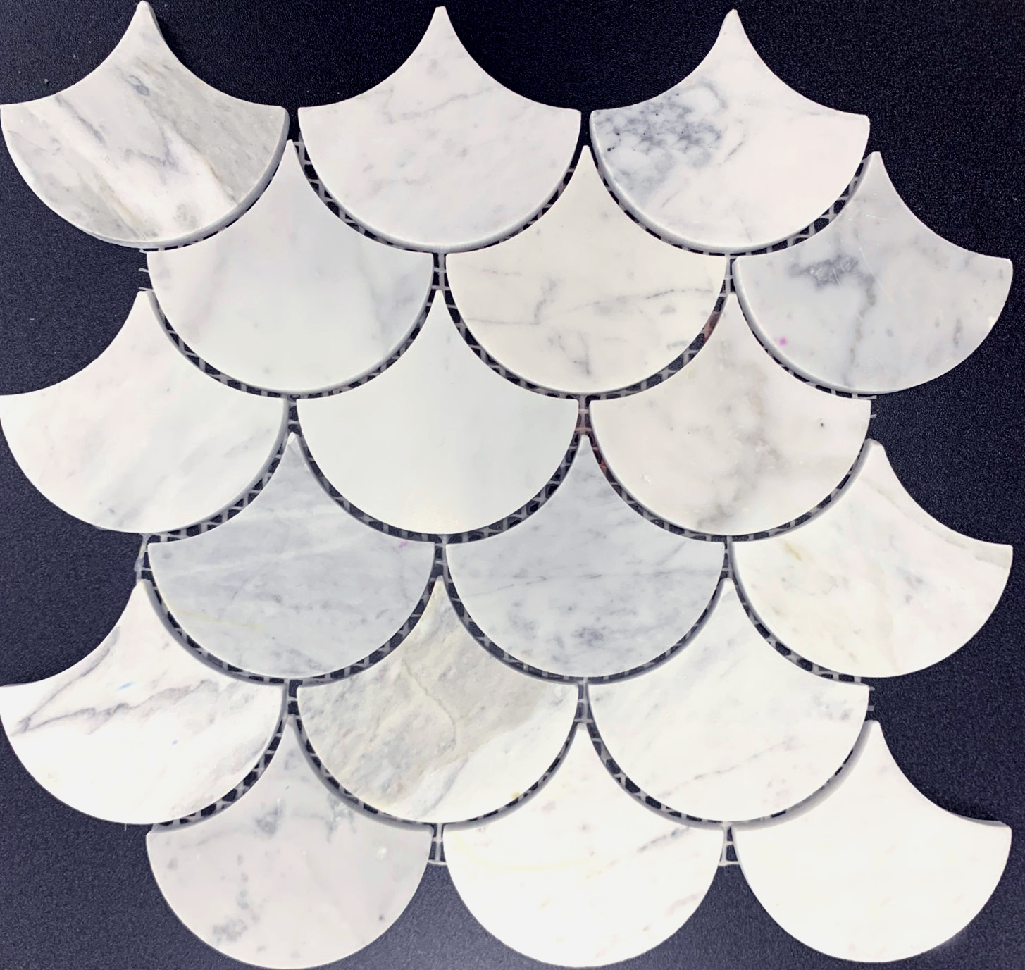
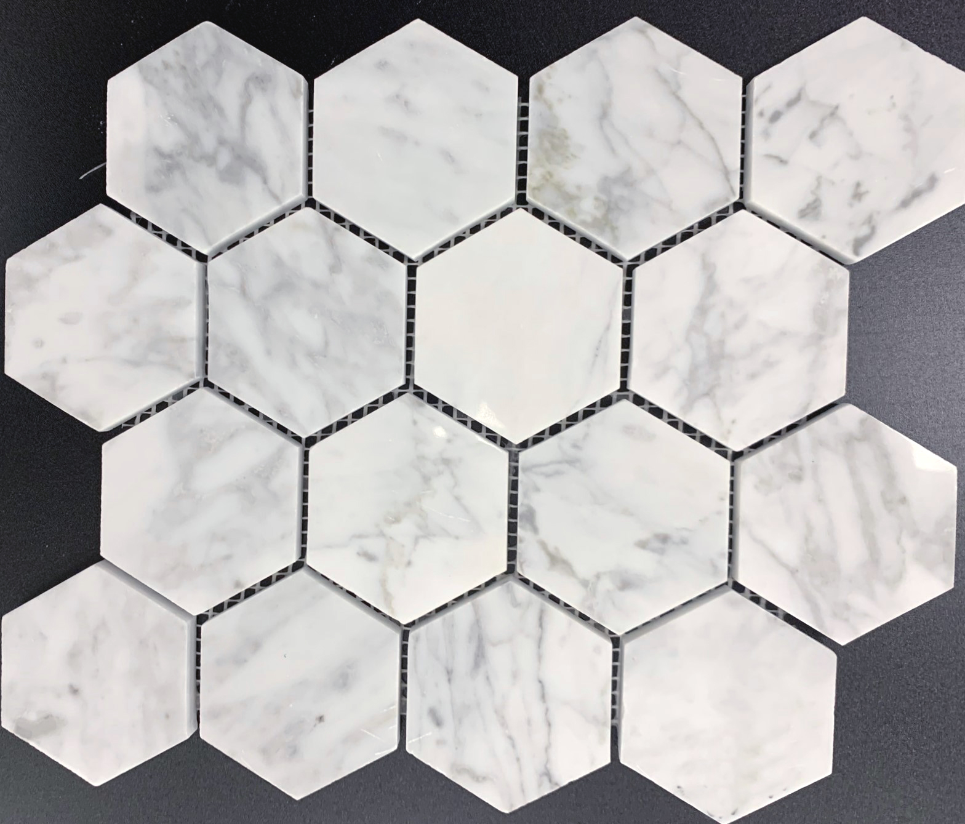
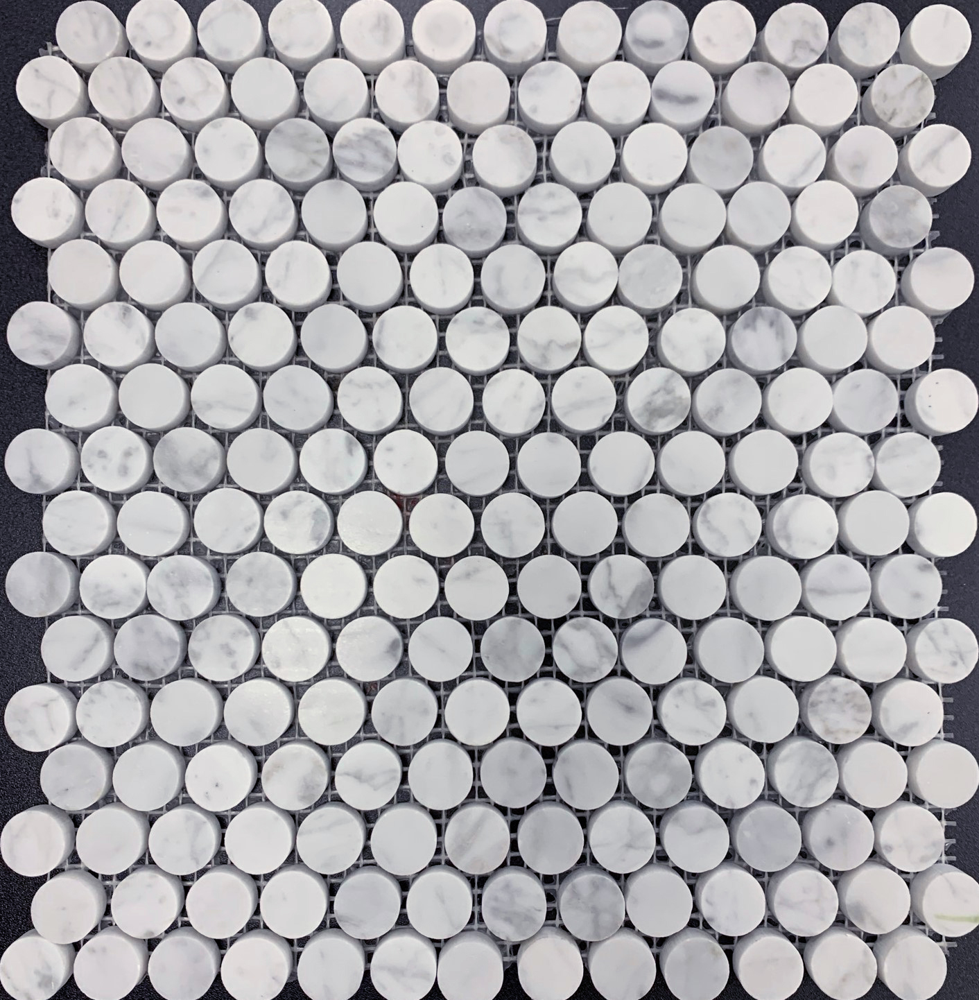
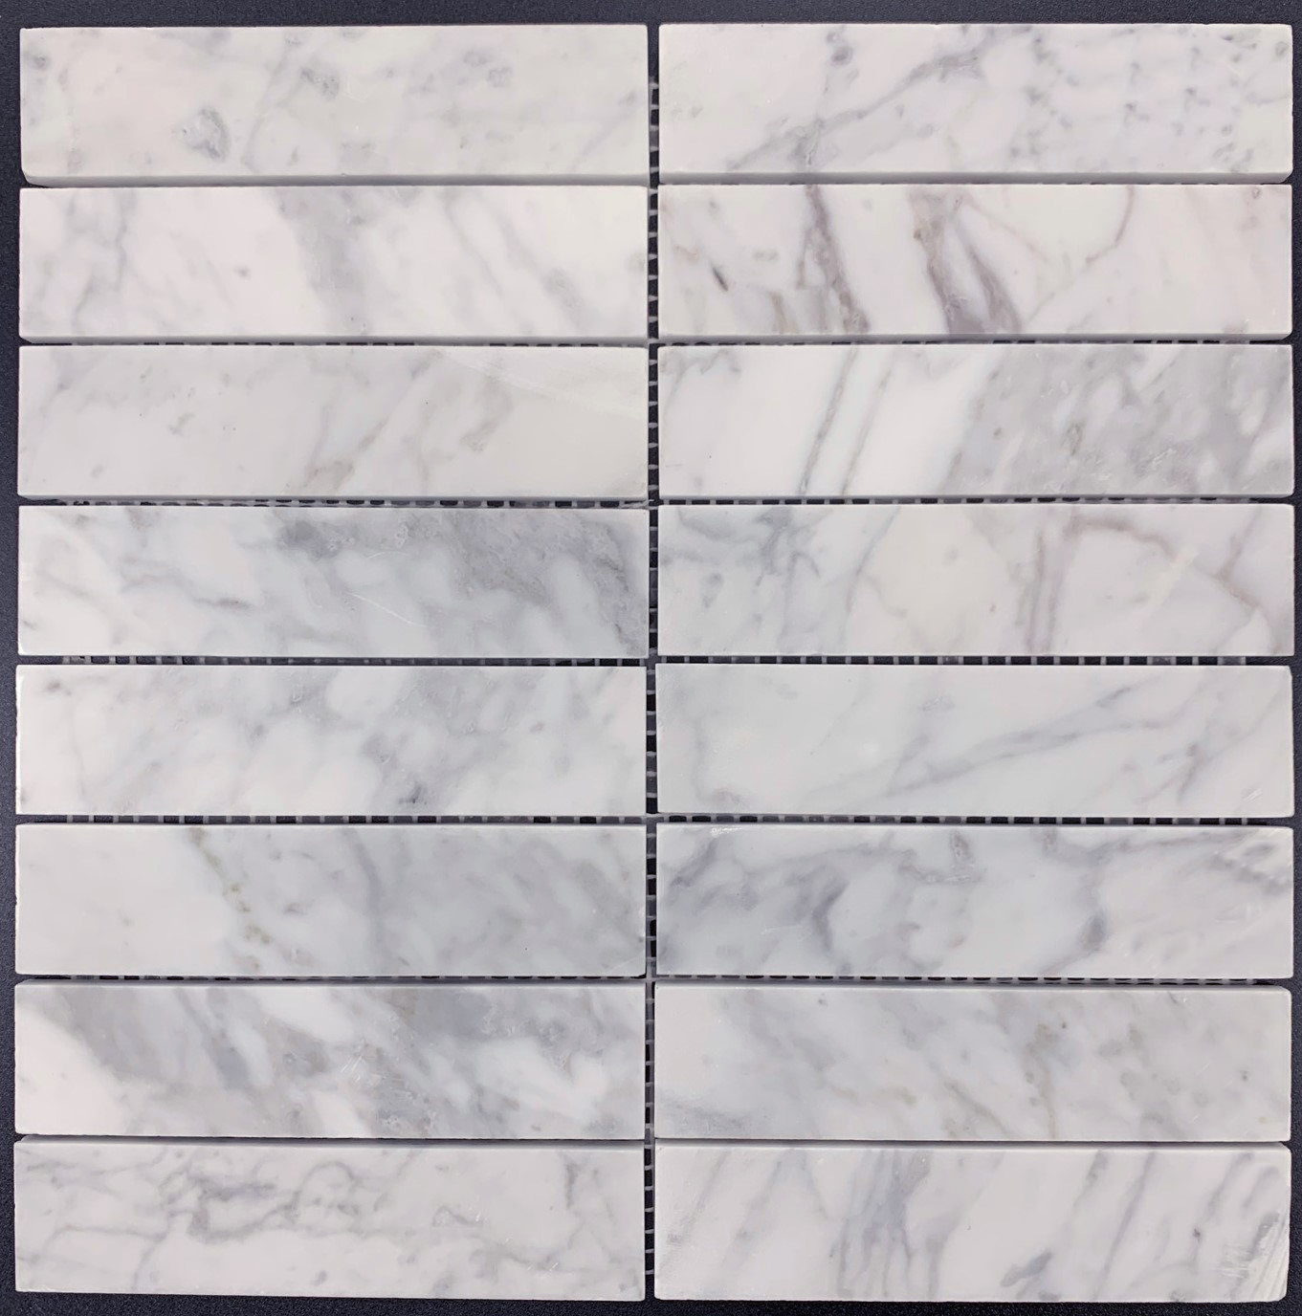
Fish Scale - Marble
(MP-WPQ3417-PC)
Marble Mosaic- Piece (225x230mm - 75mm)
Hexagon - Marble
(MP-WPQ3415-PC)
Marble Mosaic - Piece (250x290mm - 70mm)
Penny Round - Marble
(MP-WPQ3416-PC)
Marble Mosaic - Piece (285x305mm - 20mm)
Straight- Marble
(MP-WPQ3418-PC)
Marble Mosaic - Piece (305x305mm - 36x150mm)

Slide 3
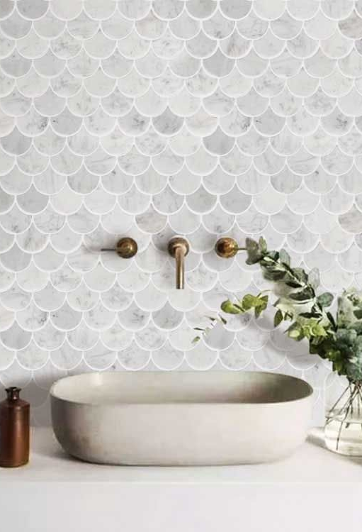
Fish Scale - Marble
(MP-WPQ3417-PC)
Marble Mosaic- Piece (225x230mm - 75mm)
Hexagon - Marble
(MP-WPQ3415-PC)
Marble Mosaic - Piece (250x290mm - 70mm)
Penny Round - Marble
(MP-WPQ3416-PC)
Marble Mosaic - Piece (285x305mm - 20mm)
Straight- Marble
(MP-WPQ3418-PC)
Marble Mosaic - Piece (305x305mm - 36x150mm)

Slide 4
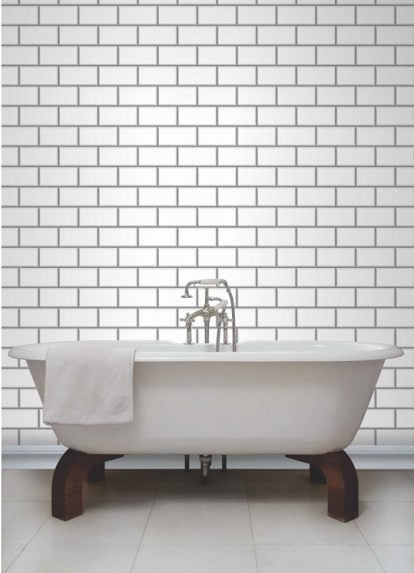
Subway Tiles(75x300mm (6mm))
Subway – White Gloss
(B-75300)
Subway – Light Grey Gloss
(B-753152)
Subway – Dark Grey Gloss
(B-753153)
Subway – Black Gloss (B-75308)
Subway Tiles (100x300mm (7mm))
Subway – White Gloss (M1300)
Subway – White Matt (OF-012)

Slide 5
Subway Tiles
Subway – White Gloss
(B-75300)
Glazed ceramic - (75x300mm (6mm))
Subway – Light Grey Gloss
(B-753152)
Glazed ceramic - (75x300mm (6mm))
Subway – Dark Grey Gloss
(B-753153)
Glazed ceramic - (75x300mm (6mm))
Subway – Black Gloss
(B-75308)
Glazed ceramic - (75x300mm (6mm))
Subway – White Gloss
(M1300)
Glazed Ceramic - (100x300mm (7mm))
Subway – White Matt
(OF-012)
Glazed Ceramic - (100x300mm (7mm))

Slide 6
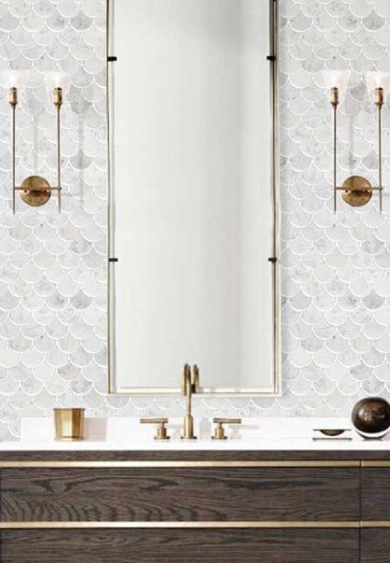
KAJARIA TILES AUSTRALIA
ABN: 49 152 252 429
Phone: +61 3 8759 5042 Email: info@kajariatiles.com.au
Locations
DOVETON SHOWROOM
Unit 2, 10 Princes Highway
Doveton, VIC, 3177
CAMPBELLFIELD SHOWROOM
31A Metrolink Circuit,
Campbellfield, VIC, 3061
Phone: +61 3 8759 5042 Email: info@kajariatiles.com.au
https://kajariatiles.com.au/

